Slide 1
Master Facilities Plan
Feedback 2025

Slide 2
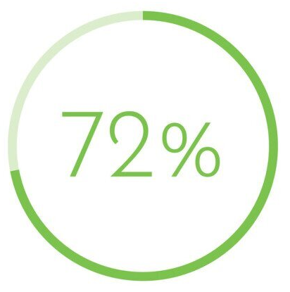
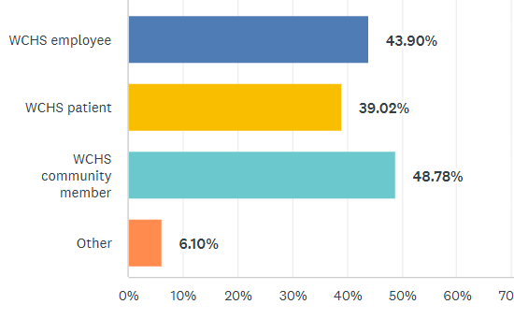
Survey Audience – 246 Response
Male
Female
Primarily Adults
*We did not ask based on where we received submissions.

Slide 3
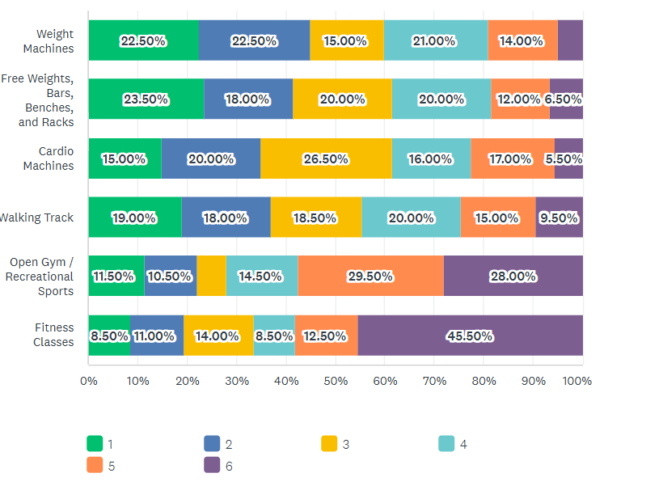
Ranking of strength and endurance features
Most Important
Least Important
Free Weights/Bars/Racks
Weight Machines
Walk Track
Cardio Machines

Slide 4
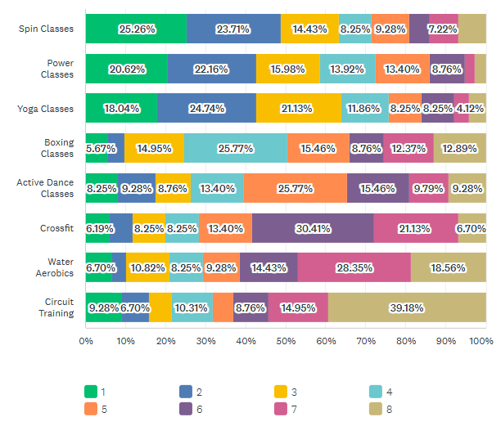
Ranking of fitness classes
More Interested
Less Interested
Priority: Spin, Power, Yoga
Mild Interest: Active Dance and Circuit
Most Polarizing: Circuit

Slide 5
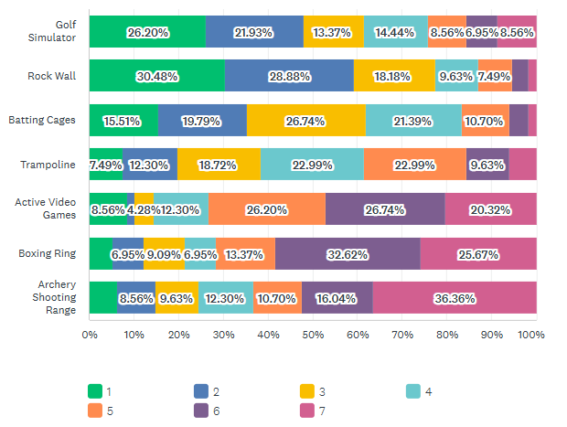
Features that would motivate you to use our facility
More exciting
Less Exciting
Priority: Golf Simulator, Rock Wall
Secondary: Batting Cages
Mild Interest: Trampoline, Active Video Games, Archery

Slide 6
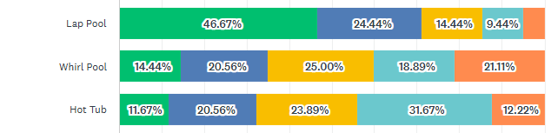

Water Wellness
Priority: Lap Pool
Secondary: Therapy Pool or Whirl Pool
Mild Interest: Hot Tub
Not Interested: Sauna
(separate from community pool)
More Interested
Less Interested

Slide 7
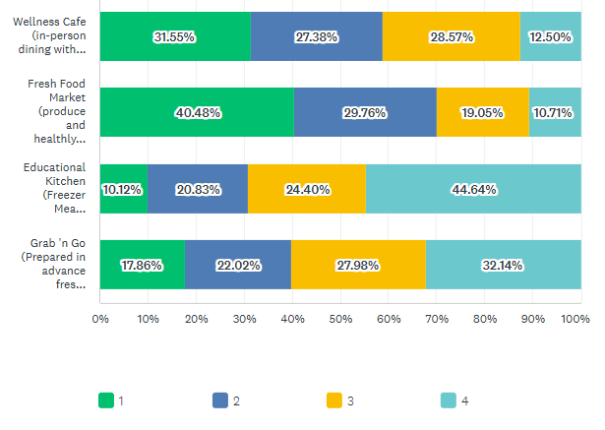
Nutrition services by importance
Priority: Fresh Food Market
Secondary: Wellness Café

Slide 8
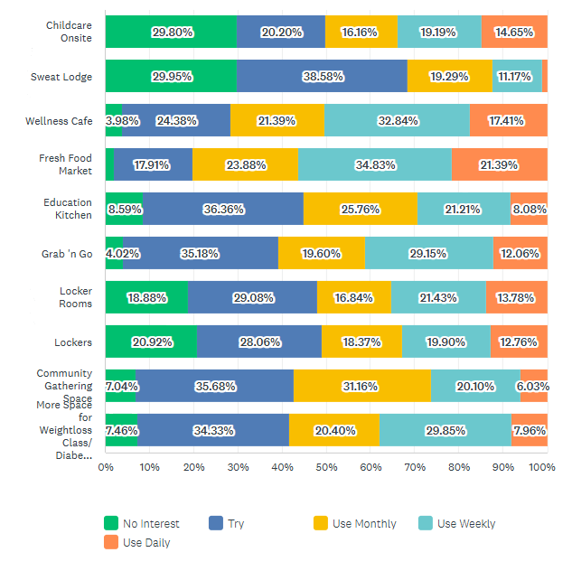
Services/Features by Anticipated Frequency of Use
Priority
Fresh Food Market
Wellness Café
Grab n Go
Secondary
4. Locker rooms/ Lockers
6. Childcare
7. Weight Management Classes / Groups

Slide 9
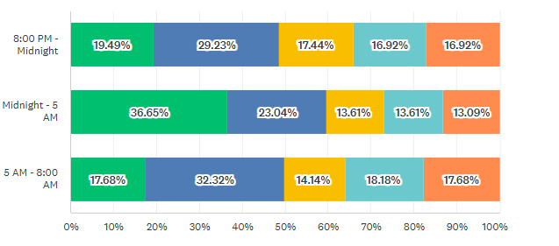
Extended Hours by Anticipated Frequency of Use
Priority: Early Mornings
Secondary: Late Nights

Slide 10
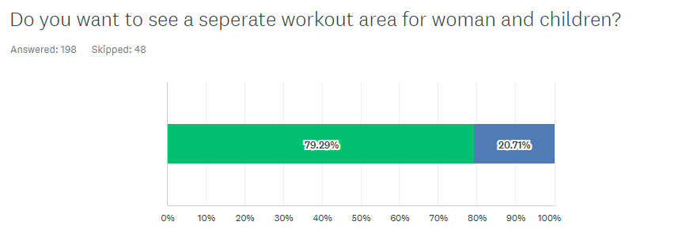
Separate Area of Women and Children

Slide 11
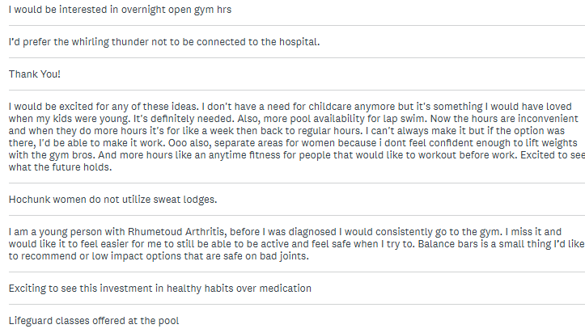
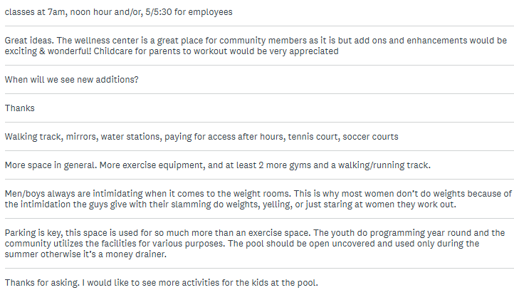
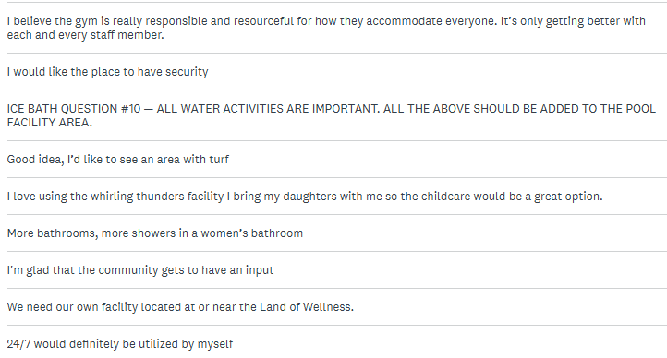
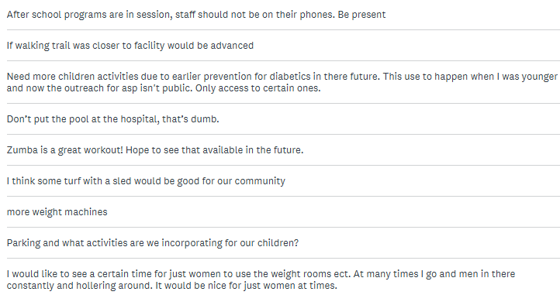
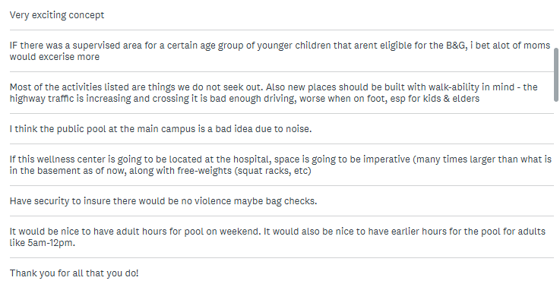
Other Comments

Slide 12
Community Pool
Feedback 2025

Slide 13
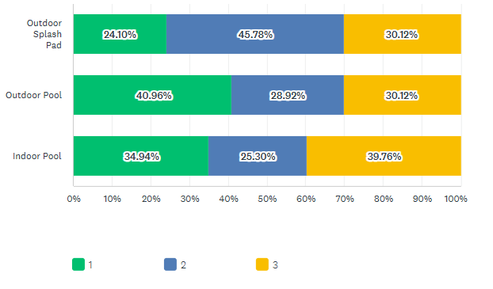
Maintaining the current pool is not an option.
Types of community pool ranked in order of interest/use.
Outdoor Pool
Splash Pad
Indoor Pool

Slide 14
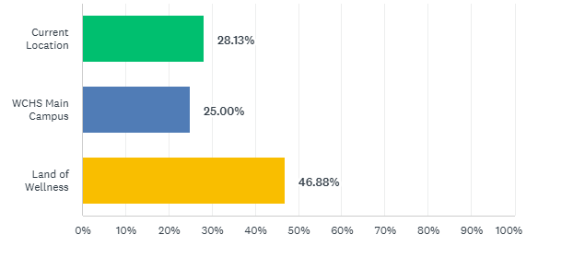
Where should we put a community pool?
1. Land of Wellness
2. Current Location

Slide 15
Where would you and your family most utilize a community pool?
1. Land of Wellness
2. Current Location

Slide 16
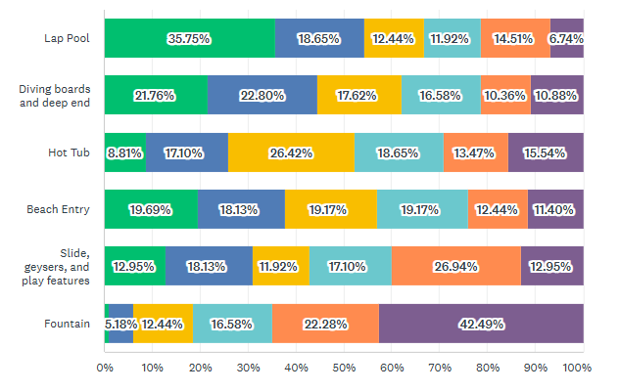
What community pool features would you like:
More Interest
No Interest
Lap Pool (This may be included in Whirling Thunder 2.0)
Priorities:
Diving Boards/deep Ends
Beach entry
Play Features: Slides / Geysers

Slide 17
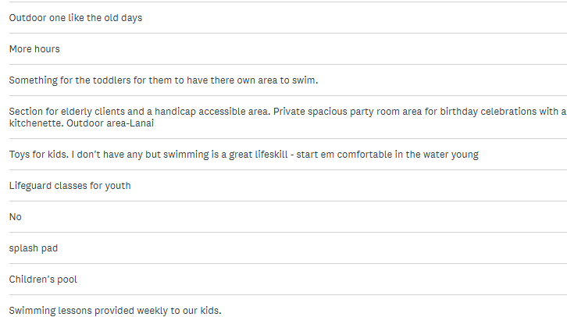
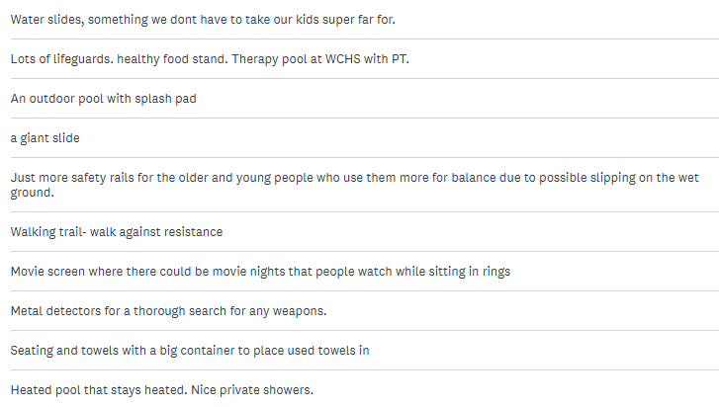
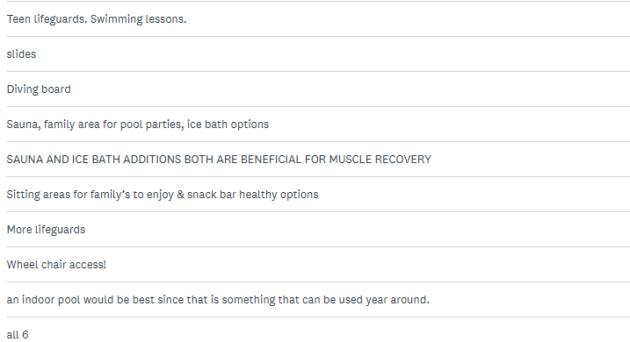
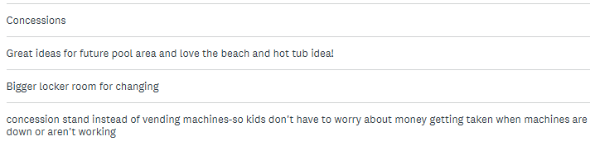
Other Comments

